Slide 1
Proposed Additions to Stack Overflow
Images taken from Stack Overflow

Slide 2
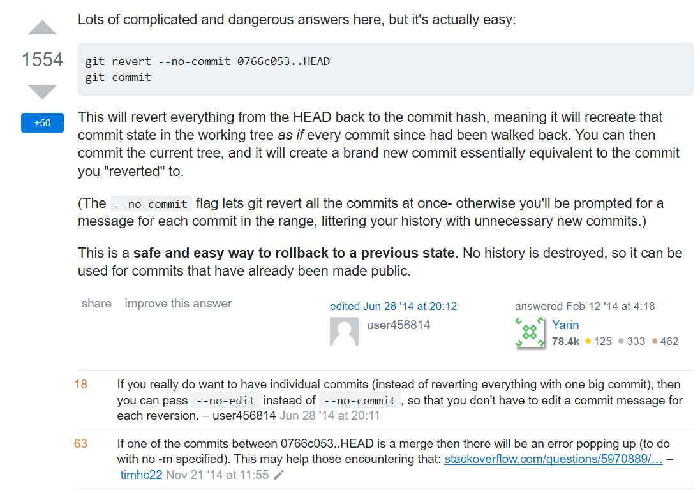
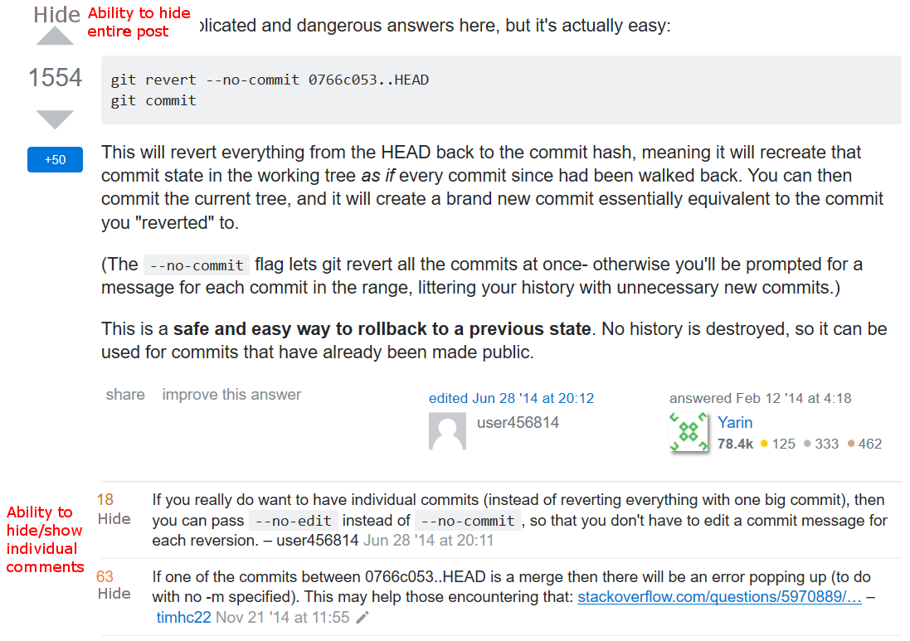
Hiding Responses
Current
Proposed

Slide 3
Hiding Responses
The ability to hide comments and responses would allow users to condense pages considerably
Would lessen the amount people are attacked for “gratuitous” responses
Users can hide responses, so no reason to call out others for it
If top answer is not helpful for users, they can easily narrow down their focus on more helpful information more quickly

Slide 4
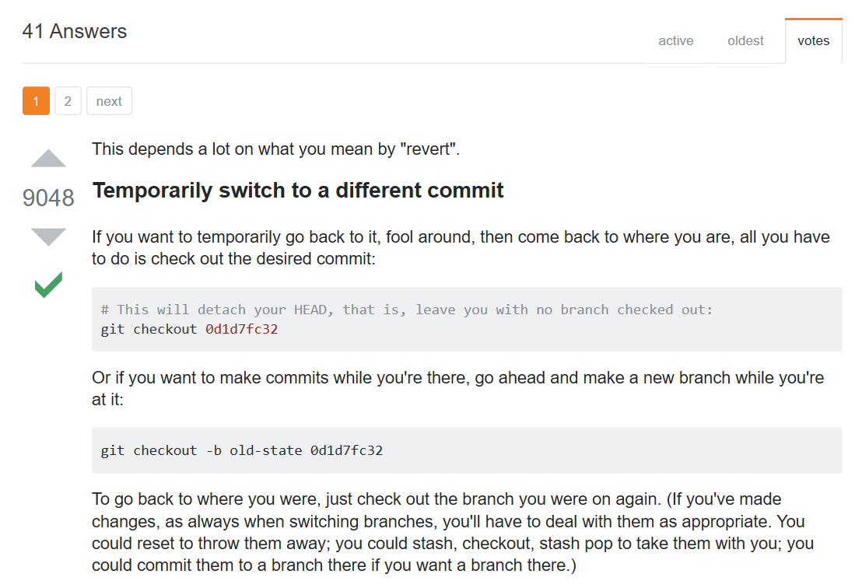
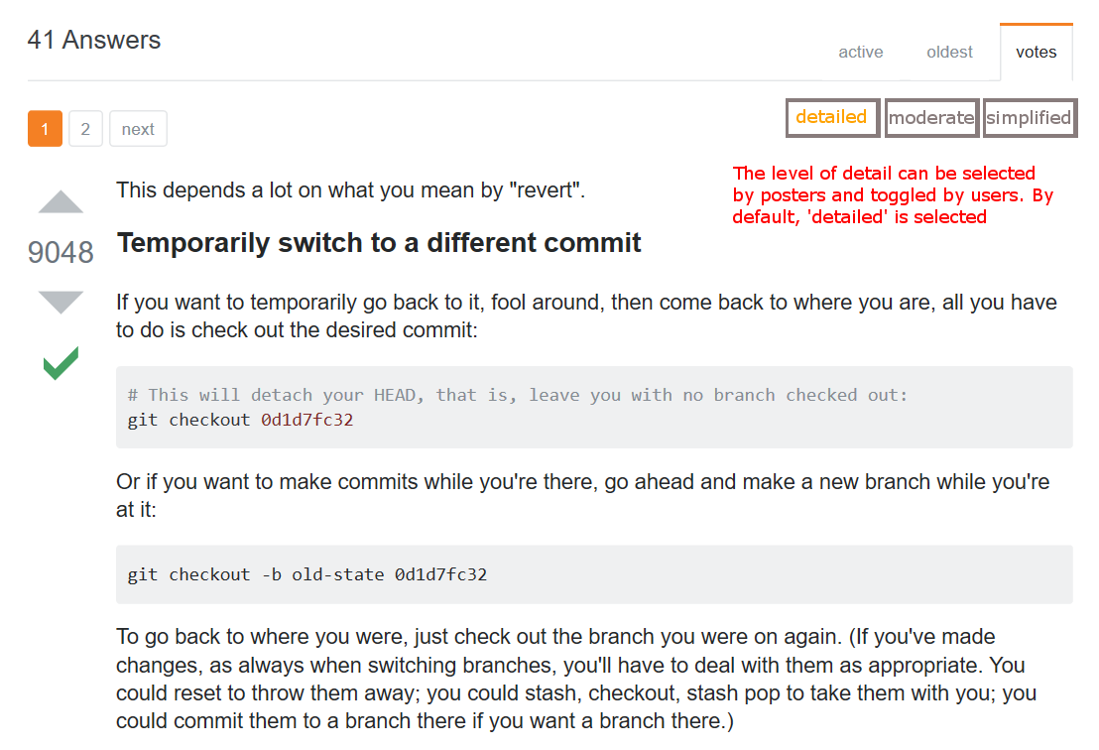
Specificity Track
Current
Proposed

Slide 5
Specificity Track
Lowers threshold for users to contribute
Still maintains quality of information users expect from stack overflow
Provides varying levels of detail that are helpful for different users
Additional means of filtering information and making page more concise

